Slide 1
FHIM and FHIR, One year later
Last updated: February 9, 2016

Slide 2
FHIM High Level Model Driven Methodology for Implementable (Runtime) Artifacts
Agency participants on FHIM calls
Requirements derived from existing specifications
FHIM Content Requirements UML Class Model
& Terminologies
Model to Model Transformations
UML Profile: CDA
UML Profile: FHIR
UML Profile: NIEM
NIEM IG
NIEM IG
NIEM IG
NIEM IG
NIEM IG
NIEM IG
CDA IG, Java, XML
FHIR IG, Java, JSON
NIEM IG, etc.
Notes:
High-level FHIM / MDHT concept.
The FHIM is a conceptual UML model that harmonizes requirements from various federal interoperability use cases.
MDHT is a tool that can use UML profiles to generate design artifacts such as implementation guides, as well as java classes to create or validate instances of specifications.

Slide 3
FHIM Model to Model Transformations Status
FHIM to CDA
Developed proof of architecture supporting the creation of a CDA implementation guide, previously demonstrated.
FHIM to NIEM
Developed proof of architecture supporting the creation of a NIEM IEPD, previously demonstrated.
FHIM to FHIR
Developed prototype supporting the generation of a FHIR profile – will provide details

Slide 4
FHIM Development Updates
UML Stereotype and UI supporting Mapping Annotation
FHIM Mapping Reports
Improved publication process
Improved version comparison
Update to RSA 9.5

Slide 5
FHIM to FHIR Transformation Approach
Leverage existing tooling/solutions to provide low level support for FHIR
UML Based and Standards based
Leverage existing FHIR profiles
Open source

Slide 6
MDHT FHIR Updates 2015
Import the HL7 FHIR specification data types, resources, and profiles into a UML model representation.
Deliverable: a UML model imported from the HL7 FHIR September 2015 DSTU, including profiles for DAF, QICore, and USLab.
Deliverable: Eclipse tooling with user interface to select and import FHIR specification files into UML.
Use the UML model representation for FHIR profiles to implement generation of FHIR StructureDefinition files that may be loaded into any compliant FHIR server.
Deliverable: Eclipse tooling with user interface to generate a FHIR XML specification file from a UML class that represents a FHIR constraint profile.
Enhance MDHT user interface for viewing and editing FHIR UML models such that it is more accessible to non-developer clinical informaticists.
Deliverable: Eclipse tooling with user interface enhancements for FHIR modeling style. Examples screenshots are included in this report.
Develop a proof of concept demonstrating how these new MDHT features for FHIR can be used with FHIM models.
Deliverable: QVT (Query/View/Transformation) script generating a FHIR profile from a FHIM Use Case.

Slide 7
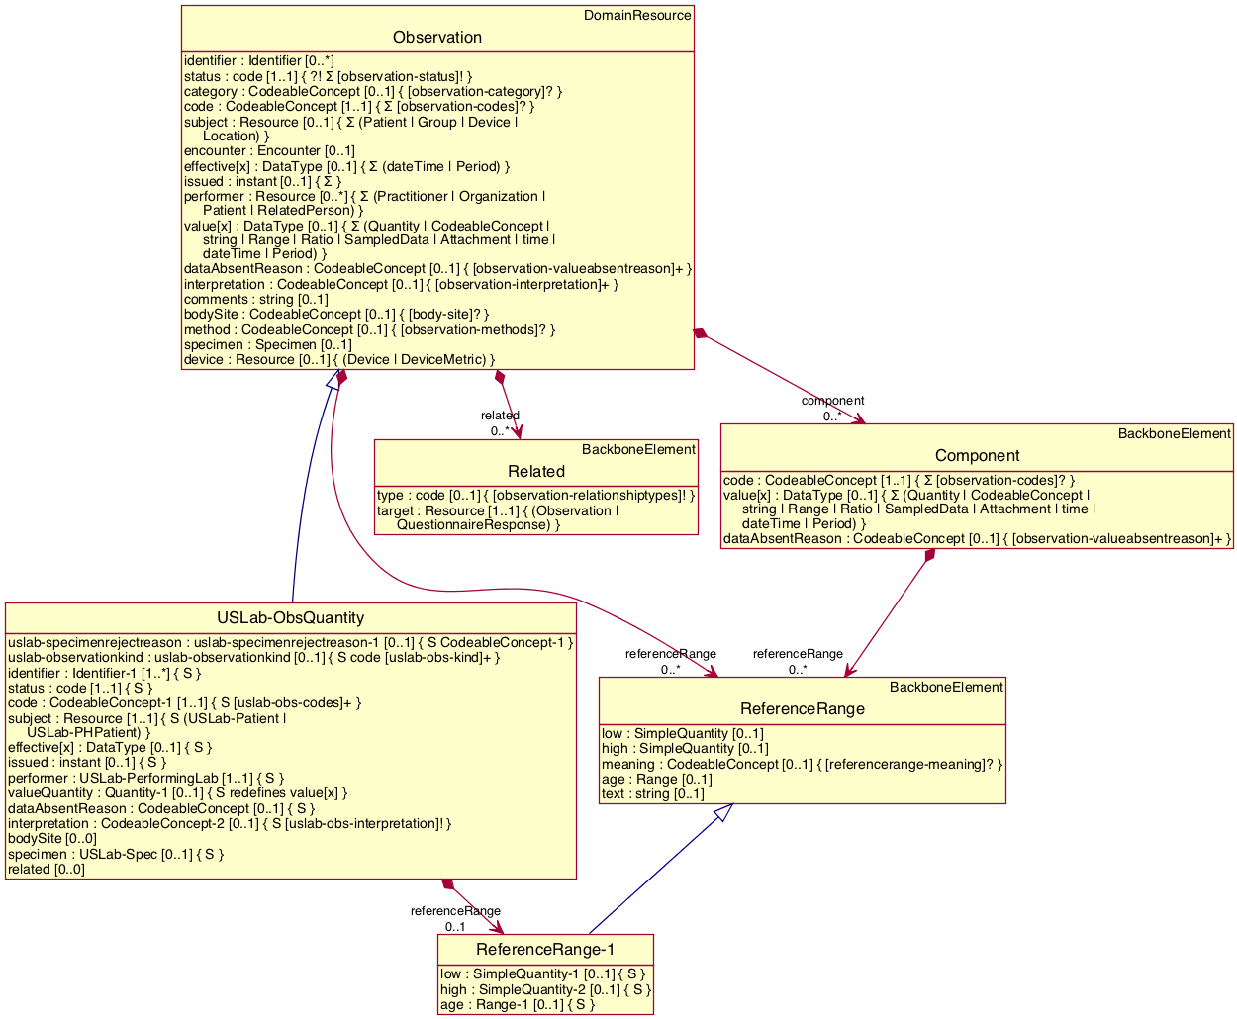
UML Representation of FHIR DSTU 2
cid:74D9D83C-3C8F-454A-A3B4-35F8AD752334@nehta.net.au
Notes:
The UML modeling style for representing constraint-based standards is an integral part of MDHT methodology and tools, and is common to most healthcare interoperability standards (i.e. a base reference model (CDA, FHIR, or NIEM Core)). It is specialized or profiled for a particular domain by defining constraints on the base model. However, data exchange is still defined by the structure of the base reference model. These model constraints include terminology and value set codes that are required within a particular domain profile, constraints on the allowed data type, or more restrictive cardinality.

Slide 8
Categories of FHIR model elements
The FHIR core specification is distributed as Structure Definition and Value Set files, in either XML or JSON format. The XML format was used to parse, transform, and import to UML models. The FHIR specification can be divided into these rough categories:
Data Types
Resources
Value Sets
Extensions
Profiles

Slide 9
Challenges Mapping FHIR Structures to UML Standard
There were a number of challenges when mapping FHIR specification structures into the UML metamodel. Whenever possible, the native UML specification semantics were leveraged and mapped to corresponding semantics in the FHIR structure definitions. Thus, validating the integrity of the UML model as per UML semantics (using any complete UML tool implementation) will also validate many corresponding aspects of FHIR semantics. A few notes about this semantic alignment are included below.

Slide 10
Element type choice
In UML, each class attribute has exactly one type, which might be a primitive data type or reference to another class. In FHIR, each structure element may have a choice of types from a list of specified data types or references to other resource types. And referenced types might be required to satisfy a particular profile.
The UML property was extended with a <<TypeChoice>> stereotype that includes a list of UML classes, where these UML classes represent the corresponding FHIR data type, core resource, or profiled type.

Slide 11
Wildcard elements and naming
Most core FHIR resources include “wildcard” elements with names such as ‘value[x]’ or ‘effective[x]’. This is tied to the element type choice, such that the [x] is replaced by a data type name from that element type choice list. In XML for JSON serialization, the element name has the [x] replaced by the type name. Thus, you get element names such as: valueQuantity, valueCodeableConcept, effectiveDateTime, etc.
This use of wildcard element is further complicated by the (sometimes inconsistent) use of both ‘value[x]’ and ‘valueCodeableConcept’ (or any other valid combination of wildcard and type name) in element names used in FHIR profile path constraints.
This complication in naming has been mostly sorted out in the import/export to UML, but additional testing is needed.
Renaming of FHIR wildcard element is mapped to UML property redefinition semantics.

Slide 12
Slicing
A FHIR structure element may be “sliced”, e.g. to allow for alternative data types, or to enable separate elements for each code in a specified value set. The UML solution is mostly complete and implemented, although some work is still required to create a UML stereotype for slicing “discriminators” and refine the FHIR/UML import/export logic.
Sliced elements in FHIR are mapped to UML property subset semantics.

Slide 13
Extensions as reusable properties
At first glance, one would expect FHIR extensions to be like adding a new attribute to a UML subclass. But, in fact, FHIR extension definition and use is just another kind of constraint on a base type.

Slide 14
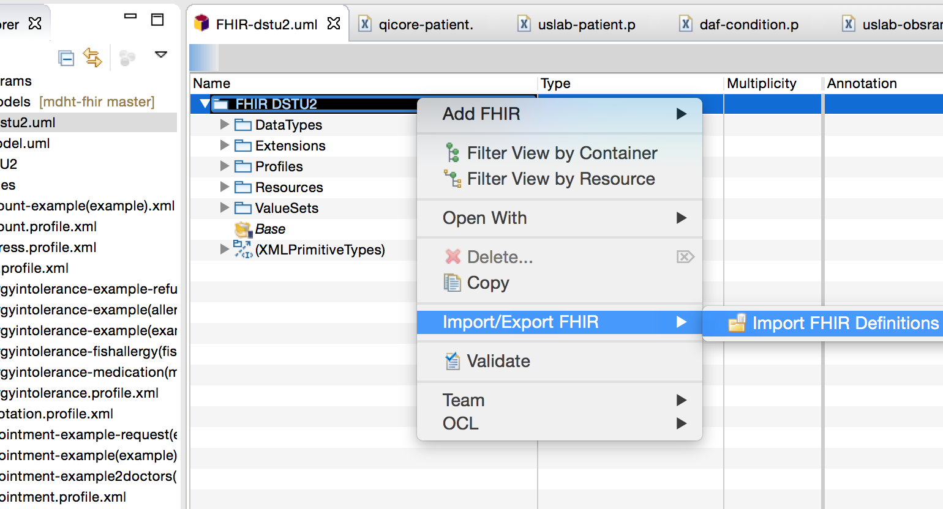
Importing FHIR Specifications to UML
Notes:
A user can download FHIR specification files from HL7, or select Structure Definition files from other sources. The XML format for FHIR Structure Definition files is required. For HL7 specifications, you can download the “validation” archive that includes files containing FHIR Bundles, or download the “examples” archive that contains individual files for each structure definition. In the screenshot shown below, the “examples” folder is shown. Choose a UML package and use the context menu comment to select a folder. All FHIR data type, resource, and profile definitions are imported to UML.

Slide 15
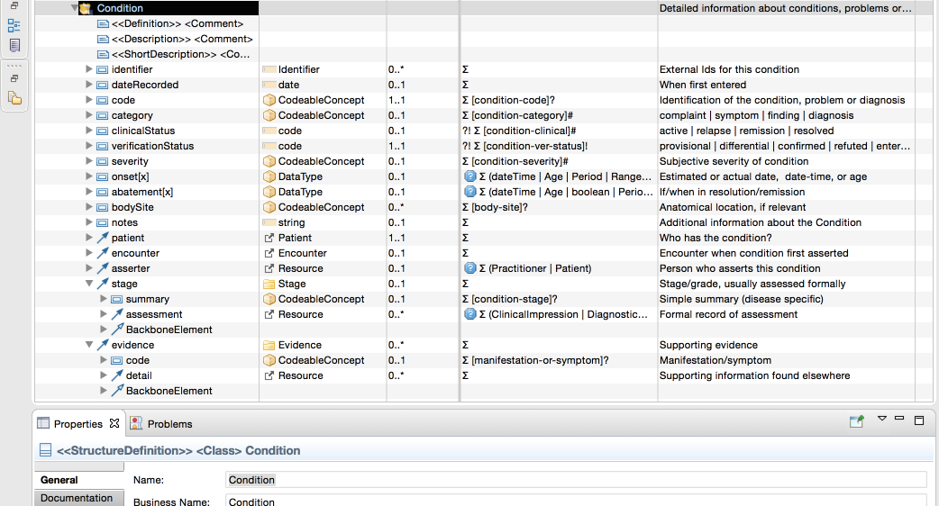
Viewing and Editing UML FHIR Models

Slide 16
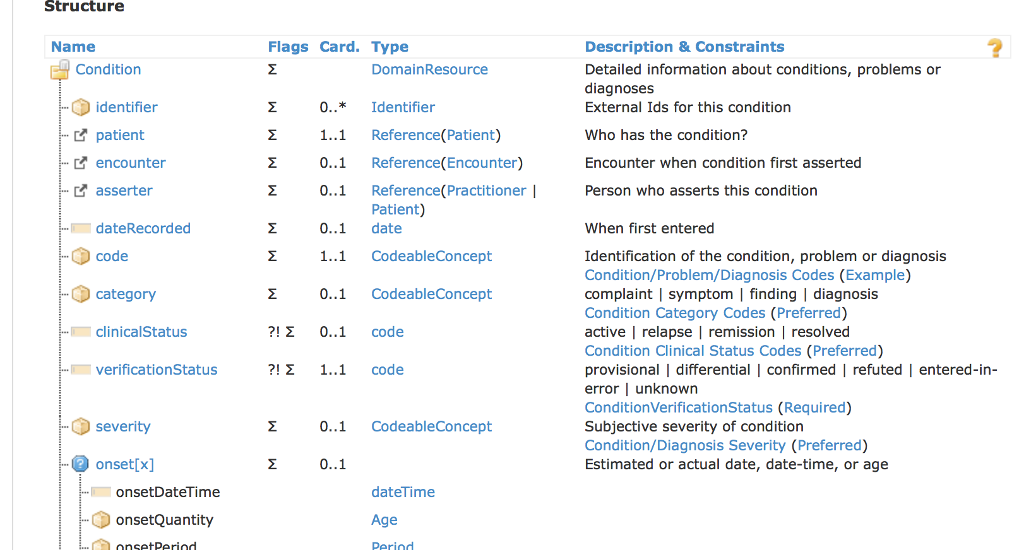
HL7’s website in HTML

Slide 17
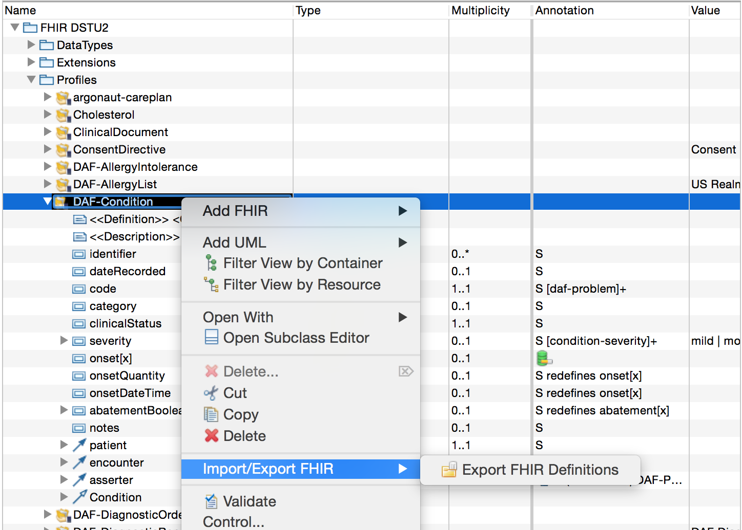
Exporting FHIR Specifications from UML
Notes:
This project’s support for MDA and FHIR must include both importing existing FHIR specifications to UML, and generating FHIR structure definition resources from UML. These generated files can then be posted to FHIR servers and used to support applications. As a demonstration of the capability that was implemented in MDHT, the following screenshots illustrate generating FHIR structure definition files from the DAF-Condition profile. Other scenarios that would use this same capability include:
Designing new FHIR profiles from within the MDHT UML editor (e.g. modifying the DAF profiles, creating new ONC FHIR profiles, VA developers creating FHIR profiles as part of VistA Evolution work, etc.)
Transforming FHIM model content to subclasses of FHIR base resources or subclasses of existing profiles, such as specialization of DAF-Condition. These transform-generated UML profile models would then be generated to FHIR structure files for deployment in applications.

Slide 18
Quick Background on QVT-Operational
The QVT standard defines three model transformation languages. All of them operate on models which conform to Meta-Object Facility (MOF) 2.0 metamodels; the transformation states which metamodels are used. A transformation in any of the three QVT languages can itself be regarded as a model, conforming to one of the metamodels specified in the standard. The QVT standard integrates the OCL 2.0 standard and also extends it with imperative features.
QVT-Operational is an imperative language designed for writing unidirectional transformations.
QVT-Relations is a declarative language designed to permit both unidirectional and bidirectional model transformations to be written. A transformation embodies a consistency relation on sets of models. Consistency can be checked by executing the transformation in check only mode; the transformation then returns True if the set of models is consistent according to the transformation and False otherwise. The same transformation can be used in enforce mode to attempt to modify one of the models so that the set of models will be consistent. The QVT-Relations language has both a textual and a graphical concrete syntax.
QVT-Core is a declarative language designed to be simple and to act as the target of translation from QVT-Relations. However, QVT-Core has never had a full implementation and in fact it is not as expressive as QVT-Relations.[2] Hence the QVT Architecture pictured above is misleading: the transformation from QVT-Relations to QVT-Core given in the QVT Standard is not semantics-preserving.

Slide 19
Generating a FHIR Profile from FHIM using QVT-Operational
mapping uml::Class::mapFromSupplier(inout profilePackage : uml::Package) {
var profile : uml::Class := profilePackage.createOwnedClass(self.name,false);
var structureDefinition : fhir::StructureDefinition := object StructureDefinition {
uri := "http://fhim.gov/fhir/StructureDefinition/"+self.name;
name := self.name;
display := "fhim-"+self.name.toLower();
fhirVersion := "dstu2";
publisher :="FHIM";
contextType :="resource";
};
Notes:
The initial version of the FHIM-to-FHIR Model-to-Model transformation is a Query/View/Transformation (QVT) script run from an eclipse environment. The Script leverages the contents from the FHIM model to create a FHIR profile. The purpose of the proof of concept is understand the complete content required by the FHIR UML tooling in order to extend/enhance if necessary the current FHIM mapping. The result is a UML model containing the FHIR profile generated from the FHIM.

Slide 20
References
FHIM Github Repository
https://github.com/orgs/FHIMS/dashboard
MDHT Eclipse Repository
https://projects.eclipse.org/projects/modeling.mdht
FHIR
https://www.hl7.org/fhir/overview.html

